Slide 1

Charter Commission
Valerie W. Mulvey, Chair
Dennis W. Cardiff, Vice-Chair
Adam S. Blumer, Clerk
Teri S. Banerjee
Dennis L. Giombetti
George P. King, Jr.
Janet E. Leombruno
Jason A. Smith
John A. Stefanini

Slide 2
Part I: Background

Slide 3
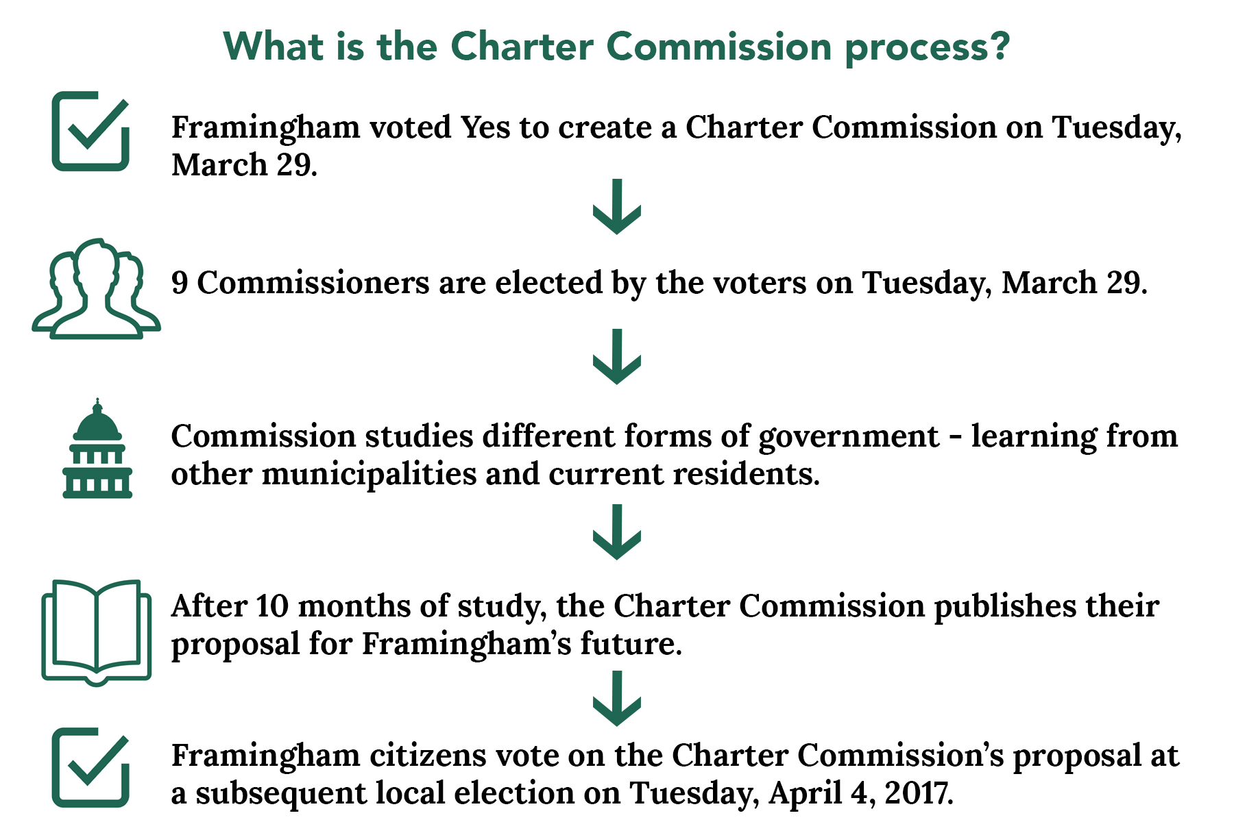

Slide 4

What is a Home Rule Charter?
A Charter is a written instrument that establishes and defines the structure of local government
A Charter may create local offices, and distribute powers, duties and responsibilities among local offices and which may establish and define certain procedures to be followed by our government approved by the voters
It serves like Framingham's constitution

Slide 5
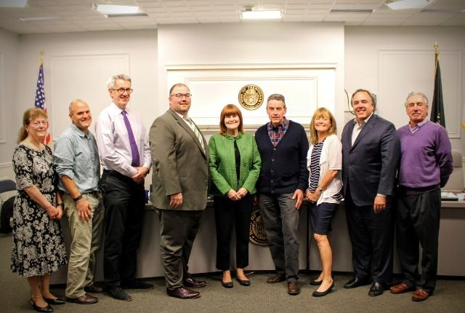
Nine Charter Commissioners
Valerie W. Mulvey, Chair
Dennis W. Cardiff, Vice-Chair
Adam S. Blumer, Clerk
Teri S. Banerjee
Dennis L. Giombetti
George P. King, Jr.
Janet E. Leombruno
Jason A. Smith
John A. Stefanini
The nine members of the Charter Commission include a former State Representative, current and former Selectmen, Town Moderator, Town Clerks, Town Meeting members, School Committee, Housing Authority, Park Commission, and Finance Committee members, Cemetery and Library trustees and former Town Managers.

Slide 6

Seven beliefs that drove our work
Framingham is a great community in which to live, learn, work and play!
Our current system of government is inefficient, and needs to be improved in order to better meet the needs of our community
The work of the Charter Commission should be done in an open and participatory manner, reaching out to a variety of stakeholders and getting feedback from the public throughout the process

Slide 7
Seven beliefs that drove our work
The new Charter should create a strong, accountable executive to advocate on our behalf with leaders in industry, government and society
The new Charter should create a legislative branch elected by all parts of our diverse community; it must provide effective checks and balances on the executive branch
The new Charter should include mechanisms that ensure that municipal leaders work collaboratively with the School Department
The new Charter must have clear ways for public to participate

Slide 8
How did we build our Charter?
Examined charters from other communities, creating ours from these: Braintree, Franklin, Newton, Waltham and Weymouth;
Met with a variety of Framingham boards, managers and community leaders to hear their thoughts;
Invited leaders from other communities to learn how other communities work;
Surveyed public and took public comments at meetings and in formal public hearings;
Published working documents online for all to review and comment as work developed and changed;
Adjusted proposal in response to input multiple times.

Slide 9
Why Change our form of Government?
Lack of transparency & accountability
Mismatch for diverse, complex community with $300M annual budget
Lack of community participation in elections
All parts of Framingham are not fairly or equally represented in elections and decision-making
Need for clear ethical standards

Slide 10
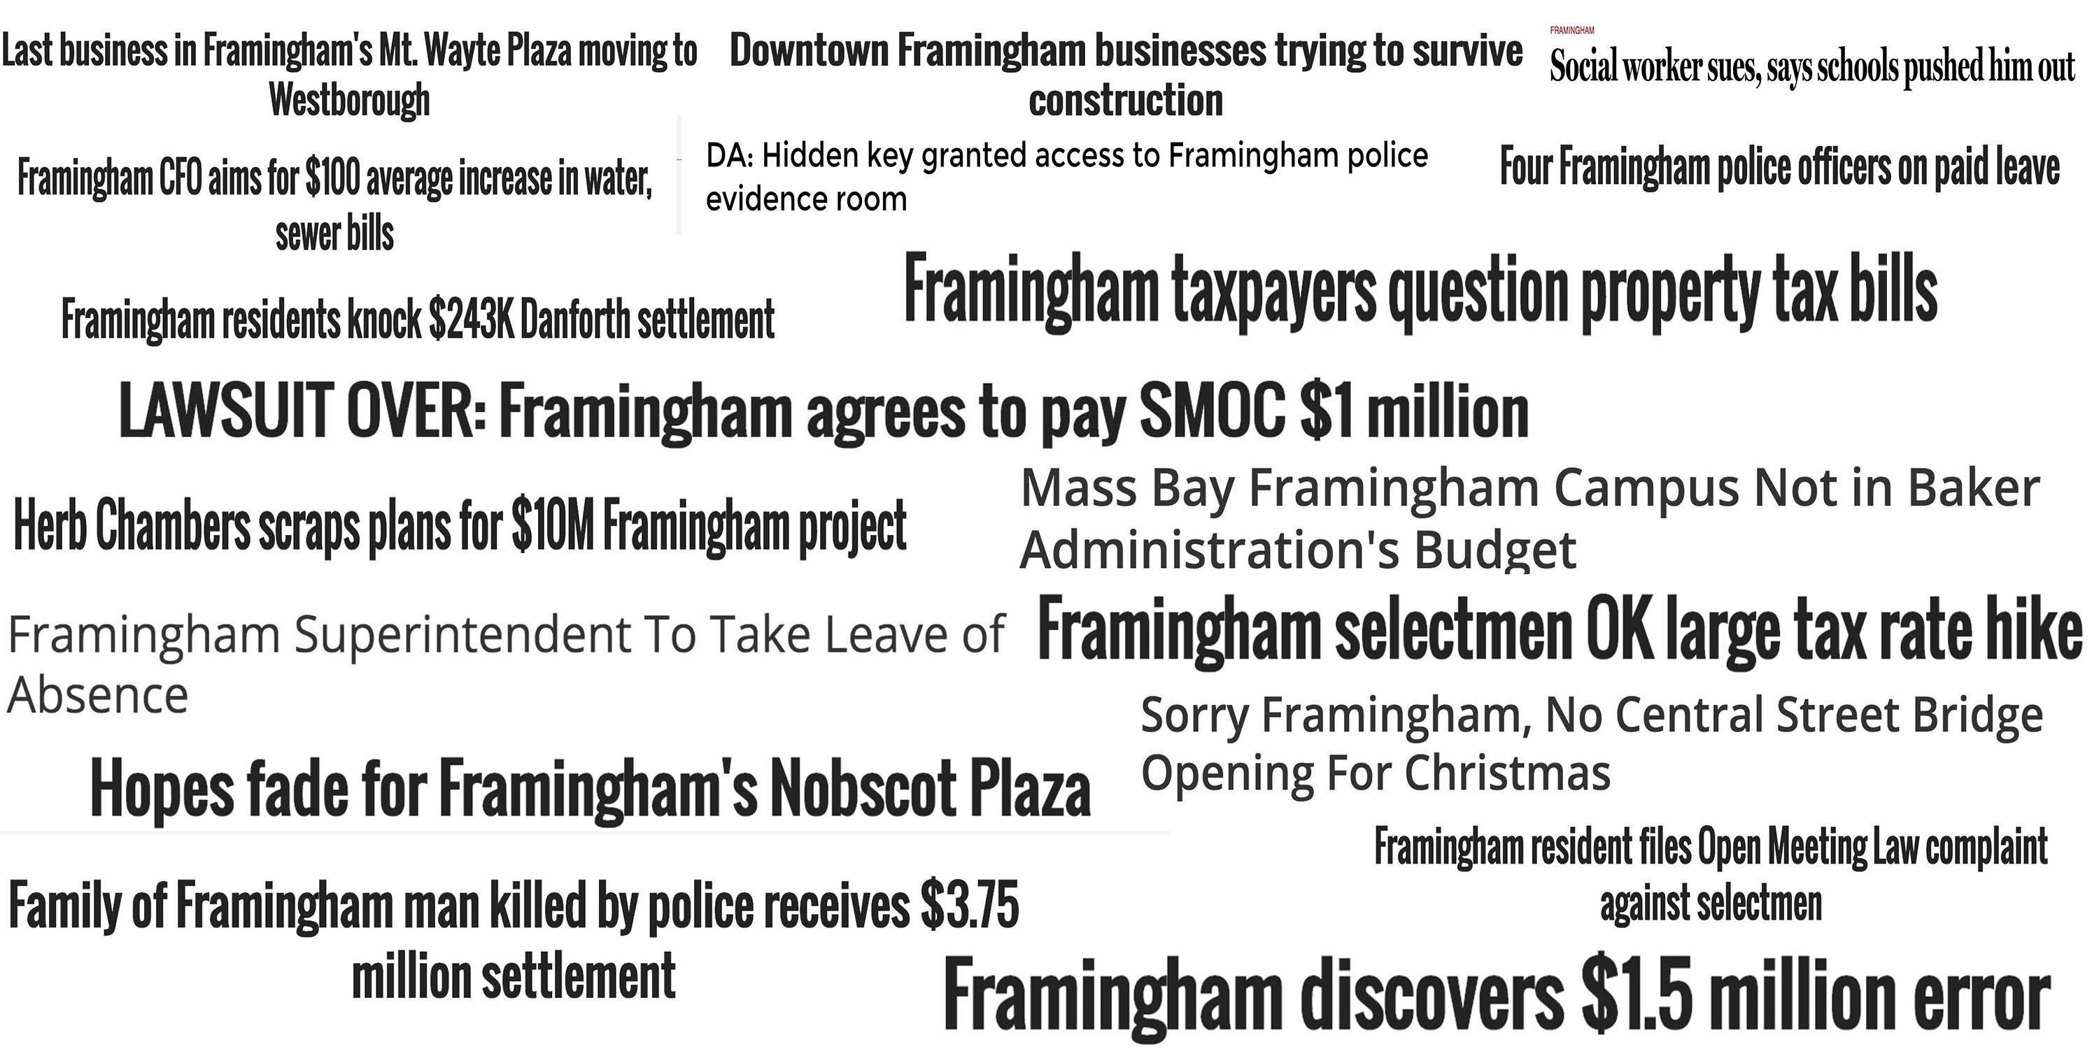
1. Who is accountable?

Slide 11
2. Mismatch for complex needs of diverse community
Hmm….
Framingham has a $300M budget, but Town Meeting only meets 2-3 times per year to discuss it

Slide 12
Mismatch creates challenges for all
Dedicated TM members have to pick up “budget story” where it left off months ago/last year and try to make best-informed decisions they can
Town Officials have to re-educate TM each year about their departments, needs, goals, challenges.
Framingham’s TM Standing committee structure requires officials to repeat same information a number of times to multiple groups, reducing their time to work on other initiatives

Slide 13
How does Framingham compare?
27 most populous communities in Massachusetts
Municipality | Land Area (Square Miles) | 2015 Total Assessed Value | 2015 Actual Expenditures | 2010 Population | City or Town | Legislative Body | Chief Execuive | Incorporation or Founding | Converted to city form | Pop. when converted to city
BOSTON | 48.43 | $128,047,080,703 | $2,422,486,726 | 617,594 | City | Council | Mayor | 1630 | 1822 | 43,298 (1820)
WORCESTER | 37.56 | $11,236,881,245 | $501,794,480 | 181,045 | City | Council | Mayor-Manager | 1684 | 1848 | 17,049 (1850)
SPRINGFIELD | 32.1 | $7,276,422,130 | $610,438,372 | 153,060 | City | Council | Mayor | 1641 | 1852 | 11,766 (1850)
LOWELL | 13.77 | $6,683,928,991 | $315,812,152 | 106,519 | City | Council | Mayor-Manager | 1826 | 1836 | 20,796 (1840)
CAMBRIDGE | 6.43 | $34,680,060,680 | $499,142,760 | 105,162 | City | Council | Mayor-Manager | 1631 | 1846 | 15,215 (1850)
NEW BEDFORD | 20.12 | $5,334,989,630 | $250,531,810 | 95,072 | City | Council | Mayor | 1786 | 1847 | 16,443 (1850)
BROCKTON | 21.47 | $6,104,303,935 | $282,026,326 | 93,810 | City | Council | Mayor | 1812 | 1881 | 13,608 (1880)
QUINCY | 16.78 | $12,019,197,110 | $283,850,033 | 92,271 | City | Council | Mayor | 1791 | 1889 | 16,723 (1890)
LYNN | 10.82 | $6,396,561,177 | $290,209,498 | 90,329 | City | Council | Mayor | 1631 | 1850 | 14,257 (1850)
FALL RIVER | 31.02 | $5,211,516,417 | $209,046,484 | 88,857 | City | Council | Mayor | 1802 | 1854 | 11,524 (1850)
NEWTON | 18.05 | $24,321,818,000 | $301,527,464 | 85,146 | City | Council | Mayor | 1691 | 1873 | 12,825 (1870)
LAWRENCE | 6.96 | $3,191,934,330 | $268,627,309 | 76,377 | City | Council | Mayor | 1847 | 1853 | 8,282 (1850)
SOMERVILLE | 4.11 | $11,198,774,270 | $201,387,380 | 75,754 | City | Council | Mayor | 1842 | 1871 | 14,685 (1870)
FRAMINGHAM | 25.12 | $7,945,015,743 | $238,310,192 | 68,318 | Town | RTM | Manager | 1700 | n/a | n/a
HAVERHILL | 33.33 | $5,432,039,234 | $165,704,510 | 60,879 | City | Council | Mayor | 1641 | 1869 | 13,092 (1870)
WALTHAM | 12.7 | $9,946,294,086 | $167,773,598 | 60,632 | City | Council | Mayor | 1737/8 | 1884 | 11,712 (1880)
MALDEN | 5.07 | $5,831,500,580 | $144,920,554 | 59,450 | City | Council | Mayor | 1649 | 1881 | 12,017 (1880)
BROOKLINE | 6.79 | $19,691,528,576 | $220,155,606 | 58,732 | Town | RTM | Manager | 1705 | n/a | n/a
PLYMOUTH | 96.46 | $9,128,500,223 | $161,300,426 | 56,468 | Town | RTM | Manager | 1620 | n/a | n/a
MEDFORD | 8.14 | $8,086,569,270 | $137,269,774 | 56,173 | City | Council | Mayor | 1630 | 1892 | 11,079 (1890)
TAUNTON | 46.61 | $4,514,347,120 | $173,775,080 | 55,874 | City | Council | Mayor | 1639 | 1864 | 15,376 (1860)
CHICOPEE | 22.87 | $3,729,040,780 | $157,142,169 | 55,298 | City | Council | Mayor | 1848 | 1890 | 14,050 (1890)
WEYMOUTH | 17.01 | $6,683,708,920 | $121,612,682 | 53,743 | City | Council | Mayor | 1630 | 1999 | 53,988 (2000)
REVERE | 5.91 | $4,606,033,831 | $154,902,362 | 51,755 | City | Council | Mayor | 1846 | 1914 | 18,219 (1910)
PEABODY | 16.4 | $6,750,057,897 | $153,580,514 | 51,251 | City | Council | Mayor | 1855 | 1916 | 19,552 (1920)
METHUEN | 22.4 | $4,804,659,354 | $130,427,701 | 47,255 | City | Council | Mayor | 1725/6 | 1972 | 35,456 (1970)
BARNSTABLE | 60.04 | $13,142,891,360 | $132,697,958 | 45,193 | City | Council | Manager | 1638 | 1989 | 40,949 (1990)

Slide 14
Results of this mismatch
How sure are we that this was all money well spent?
65%
11.8%
33%

Slide 15
Results of this mismatch
How sure are we that this was all money well spent?
65%
11.8%
33%
How much Framingham’s government expenditures have grown over the last decade
How much Framingham’s
government workforce has grown over the last decade
How much the average single family tax bill has increased in the last decade

Slide 16
Framingham by the Numbers
Expenditures over the past ten years (2007 to 2016)
Year | General Fund Expenditures | Assessed Value: Residential | Assessed Value: Commsercial | Assessed Value: Industrial | Assessed Value: Personal Property | Total Assessed Value | Enterprise Funds | Total Employees
2016 | 253,397,784 | $6,081,822,099 | $1,346,998,840 | $261,459,900 | $254,734,904 | $7,945,015,743 | $42,097,302 | 3,228
2015 | $238,310,192 | $5,818,671,300 | $1,299,872,350 | $267,785,500 | $223,149,421 | $7,609,478,571 | $39,676,677 | 3,129
2014 | $196,348,058 | $5,569,402,378 | $1,200,300,512 | $244,817,100 | $227,073,797 | $7,241,593,787 | $37,969,048 | 2,990
2013 | $187,082,996 | $5,581,503,793 | $1,204,498,235 | $239,864,800 | $242,767,540 | $7,268,634,368 | $34,367,071 | 2,827
2012 | $176,254,028 | $5,816,343,243 | $1,215,435,396 | $249,626,900 | $248,330,938 | $7,529,736,477 | $33,499,695 | 2,824
2011 | $172,532,661 | $5,628,822,015 | $1,313,175,863 | $251,056,800 | $266,559,086 | $7,459,613,764 | $29,153,668 | 2,874
2010 | $168,394,850 | $5,981,560,227 | $1,433,528,853 | $249,292,200 | $270,100,034 | $7,934,481,314 | $27,285,193 | 2,831
2009 | $167,353,237 | $6,632,001,517 | $1,563,465,663 | $286,796,500 | $252,186,907 | $8,734,450,587 | $26,139,210 | 2,910
2008 | $163,848,098 | $6,809,303,945 | $1,464,404,355 | $276,993,200 | $250,691,229 | $8,801,392,729 | $24,542,923 | 2,906
2007 | $155,108,561 | $6,801,720,097 | $1,435,991,403 | $268,539,300 | $235,186,805 | $8,741,437,605 | $23,468,394 | 2,887
2006 | $173,228,332 | $6,670,369,564 | $1,433,783,036 | $260,586,300 | $226,551,214 | $8,591,290,114 | $21,049,644 | 2,882
2005 | $166,661,632 | $6,010,659,665 | $1,308,410,835 | $241,211,000 | $202,287,467 | $7,762,568,967 | $19,506,722 | 2,838

Slide 17
Average Residential Tax Bill
Average tax for 27 most populous MA communities
Municipality | 2015 Actual Expenditures | 2010 Population | Average 2015 Single Family Tax Bill | 2016 Residential Tax Rate | 2016 Single Family Parcels | 2016 Multi Family Parcels | 2016 Condos | 2016 Commercial Parcels | 2016 Industrial Parcels | 2016 Total Parcels
BOSTON | $2,422,486,726 | 617,594 |  | $11.00 | 30,606 | 31,201 | 60,283 | 8,007 | 662 | 149,515
WORCESTER | $501,794,480 | 181,045 | $3,756 | $20.61 | 25,098 | 8,491 | 4,886 | 2,202 | 567 | 45,115
SPRINGFIELD | $610,438,372 | 153,060 | $2,587 | $19.66 | 26,140 | 7,604 | 1,877 | 2,226 | 351 | 42,243
LOWELL | $315,812,152 | 106,519 | $3,480 | $15.16 | 11,846 | 4,492 | 5,401 | 1,201 | 454 | 25,815
CAMBRIDGE | $499,142,760 | 105,162 |  | $6.99 | 3,864 | 3,720 | 14,233 | 1,095 | 181 | 24,573
NEW BEDFORD | $250,531,810 | 95,072 | $2,918 | $16.49 | 12,429 | 6,912 | 1,071 | 1,414 | 463 | 25,377
BROCKTON | $282,026,326 | 93,810 | $3,328 | $17.36 | 16,532 | 3,494 | 2,094 | 1,471 | 277 | 25,928
QUINCY | $283,850,033 | 92,271 | $4,981 | $14.36 | 13,673 | 3,760 | 6,039 | 975 | 97 | 26,138
LYNN | $290,209,498 | 90,329 | $3,929 | $16.18 | 11,564 | 4,640 | 2,657 | 757 | 141 | 21,217
FALL RIVER | $209,046,484 | 88,857 | $2,705 | $13.63 | 8,882 | 5,375 | 1,820 | 1,057 | 300 | 20,786
NEWTON | $301,527,464 | 85,146 | $10,091 | $11.38 | 16,972 | 3,112 | 4,790 | 765 | 76 | 27,136
LAWRENCE | $268,627,309 | 76,377 | $2,688 | $15.51 | 4,258 | 4,468 | 1,431 | 842 | 209 | 12,846
SOMERVILLE | $201,387,380 | 75,754 |  | $12.53 | 2,341 | 7,495 | 4,953 | 596 | 105 | 16,658
FRAMINGHAM | $238,310,192 | 68,318 | $5,952 | $17.38 | 13,437 | 1,226 | 2,962 | 865 | 108 | 19,605
HAVERHILL | $165,704,510 | 60,879 | $4,114 | $15.36 | 10,386 | 2,346 | 4,964 | 623 | 233 | 20,468
WALTHAM | $167,773,598 | 60,632 |  | $12.24 | 8,703 | 1,654 | 3,218 | 727 | 184 | 15,709
MALDEN | $144,920,554 | 59,450 |  | $15.16 | 5,649 | 4,098 | 2,059 | 351 | 126 | 13,031
BROOKLINE | $220,155,606 | 58,732 |  | $10.42 | 4,575 | 1,314 | 10,011 | 468 | 7 | 17,400
PLYMOUTH | $161,300,426 | 56,468 | $4,782 | $16.27 | 18,264 | 606 | 2,888 | 736 | 297 | 26,385
MEDFORD | $137,269,774 | 56,173 | $4,615 | $11.19 | 7,874 | 4,517 | 2,980 | 608 | 84 | 17,062
TAUNTON | $173,775,080 | 55,874 | $3,441 | $15.68 | 10,529 | 2,599 | 2,064 | 665 | 153 | 18,934
CHICOPEE | $157,142,169 | 55,298 | $2,975 | $16.91 | 11,072 | 2,147 | 1,816 | 690 | 322 | 17,899
WEYMOUTH | $121,612,682 | 53,743 | $3,896 | $12.80 | 13,246 | 780 | 3,099 | 785 | 78 | 19,102
REVERE | $154,902,362 | 51,755 | $3,923 | $14.45 | 4,494 | 4,348 | 2,648 | 581 | 77 | 14,129
PEABODY | $153,580,514 | 51,251 | $3,960 | $11.92 | 10,877 | 1,166 | 2,270 | 583 | 182 | 15,981
METHUEN | $130,427,701 | 47,255 | $3,955 | $14.81 | 10,737 | 1,273 | 2,421 | 462 | 148 | 16,485
BARNSTABLE | $132,697,958 | 45,193 |  | $9.31 | 20,861 | 279 | 1,725 | 1,708 | 92 | 27,532

Slide 18
3. Lack of Community Participation
Average turnout over the past ten years (2007 to 2016)
Local Turnout Average= 10.35%
Source: Framingham election summary

Slide 19
Declining Election Turnout
Vote to form Charter Commission
Source: Framingham election summary

Slide 20
4. Unequal Representation
How do these numbers connect?
3 720

Slide 21
4. Unequal Representation
How do these numbers connect?
3 720
In last 10 years, there have been 3 formally contested town meeting races out of 720 possible races
Vacancies in town meeting reduce equity in representation between different parts of town
Members of key boards like Selectmen, School Committee, etc. do not currently come equally from different parts of our community

Slide 22
Part II:
A closer look at Charter

Slide 23

What’s new in our Charter?
It focuses elections on our neighborhoods, creating accountable leaders selected through a more competitive process
It establishes a system of strong checks and balances between various segments of government
It creates a first ever strategic plan and master plan for our community

Slide 24
What’s new in our Charter?
It requires elected and appointed leaders to report their financial interests, follow state’s ethics laws and prohibits self-dealing
It provides residents with relief measures such as ability to recall elected officials, petition Council & School Committee, and place initiatives and referendums on the ballot
It gives timely information to the public by requiring budget information and ordinances be posted online

Slide 25
What’s new in our Charter?
It gives the Council the right to approve all mayoral appointments (as opposed to current limited approvals of Selectmen)
It creates a Citizen Participation Officer, to develop strategies to maximize public engagement
It establishes a Strategic Initiative & Finance Oversight Committee, a 9 member citizen watchdog group providing input and oversight into our long-term municipal finances

Slide 26

What’s new in our Charter?
Establishes a Traffic Commission to address traffic congestion
It requires that all council meetings are broadcast live and recorded for future viewing by the public
Adopts strictest state reporting and oversight of campaign activity.

Slide 27
Town Council: More details
Town Meeting replaced with an 11-member Town Council, with nine (9) members elected from neighborhood districts and two elected “at large” from across town
District Councilors serve for 2 years, “at large” councilors for 4 years
A Powerful council with ability to pass ordinances as well as to approve or reject Mayoral appointments
Town Council sets its own agenda and meets regularly, at least monthly

Slide 28
Nine Neighborhood Districts
District | Precinct | # of Residents
District 1 | 1 | 3728
 | 2 | 3833
District 2 | 3 | 3717
 | 5 | 3611
District 3 | 4 | 3682
 | 7 | 3877
District 4 | 6 | 3687
 | 9 | 3704
District 5 | 8 | 3829
 | 12 | 3934
District 6 | 10 | 3933
 | 11 | 3876
District 7 | 13 | 3815
 | 14 | 3906
District 8 | 15 | 3869
 | 18 | 3709
District 9 | 16 | 3761
 | 17 | 3847
 | TOTAL | 68318

Slide 29
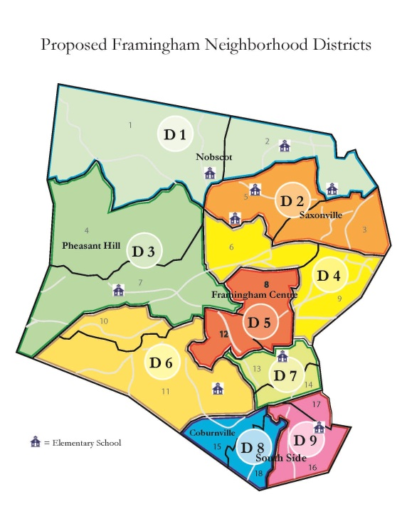

Slide 30
Advantages of Town Council
More equal representation: Each district will have a equal voice in decisions made
More accountability: Far easier for voters to know who to turn to with concerns
More frequent meetings: Can delve into issues more deeply without losing momentum
More oversight: The council will have more say in who is appointed to important committees and positions than the Selectmen or Town Meeting currently have.

Slide 31
How does our Council compare?

Slide 32
Mayor
Full-time mayor serving a 4-year term
Chief Executive directly accountable to voters
Gives our town a strong advocate with state and federal leaders
Creates a champion for the Town of Framingham
Requires Mayor to create a strategic plan and a master plan, and regularly update them
Appoints residents to boards, committees, commissions and officers with approval of Town Council

Slide 33
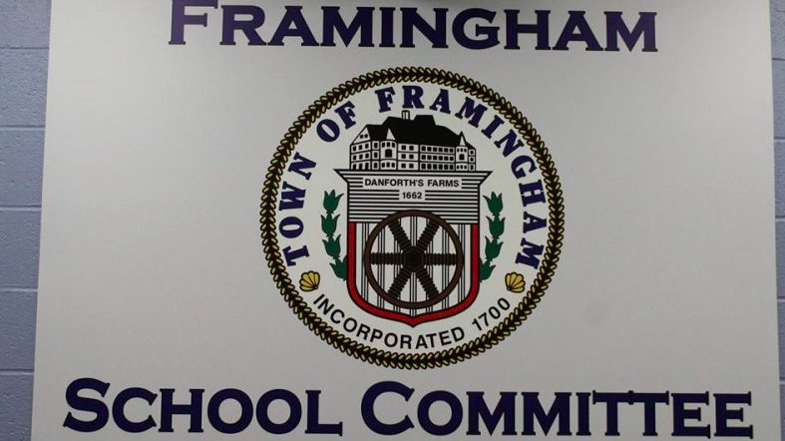
School Committee: What stays the same?
Their three main responsibilities are defined by state law and remain in new Charter:
  Hiring of Supt. and other key positions
  Recommending a budget
  Developing policies for school district

Slide 34
School Committee: What is different?
  9 members, elected by district rather than the 7 now elected “at large”
  Serve for 2 years rather than 3 years
  Mayor will be part of school committee to encourage collaboration
  Mayor cannot be chair or vice-chair to avoid Mayor having too much power over schools

Slide 35
How is School Committee structured in other communities?
Municipality | 2015 Actual Expenditures | 2010 Population | Mayoral Term | School Committee Size | School Committee District Reps | School Committee At-Large Reps | School Commitee Term | Mayor on School Committee | Mayor Chairs School Committee
BOSTON | $2,422,486,726 | 617,594 | 4 | 7 | 0 | 7 | 4 | No | No
WORCESTER | $501,794,480 | 181,045 | n/a | 7 | 0 | 6 | 2 | Yes | Yes
SPRINGFIELD | $610,438,372 | 153,060 | 4 | 7 | 4 | 2 | 2 | Yes | Yes
LOWELL | $315,812,152 | 106,519 | n/a | 7 | 0 | 6 | 2 | Yes | Yes
CAMBRIDGE | $499,142,760 | 105,162 | n/a | 7 | 0 | 6 | 2 | Yes | Yes
NEW BEDFORD | $250,531,810 | 95,072 | 2 | 7 | 0 | 6 | 4 | Yes | Yes
BROCKTON | $282,026,326 | 93,810 | 2 | 8 | 7 | 0 | 2 | Yes | Yes
QUINCY | $283,850,033 | 92,271 | 4 | 7 | 0 | 6 | 4 | Yes | Yes
LYNN | $290,209,498 | 90,329 | 2 | 7 | 0 | 6 | 2 | Yes | Yes
FALL RIVER | $209,046,484 | 88,857 | 2 | 7 | 0 | 6 | 3 | Yes | Yes
NEWTON | $301,527,464 | 85,146 | 4 | 9 | 8 | 0 | 3 | Yes | Yes
LAWRENCE | $268,627,309 | 76,377 | 4 | 7 | 6 | 0 | 2 | Yes | Yes
SOMERVILLE | $201,387,380 | 75,754 | 2 | 9 | 7 | 0 | 2 | Yes | No
FRAMINGHAM | $238,310,192 | 68,318 | 4 | 9 | 9 | 0 | 2 | Yes | No
HAVERHILL | $165,704,510 | 60,879 | 2 | 7 | 0 | 6 | 4 | Yes | Yes
WALTHAM | $167,773,598 | 60,632 | 4 | 7 | 0 | 6 | 4 | Yes | Yes
MALDEN | $144,920,554 | 59,450 | 4 | 9 | 8 | 0 | 2 | Yes | Yes
BROOKLINE | $220,155,606 | 58,732 | n/a | 9 | 0 | 9 | 3 | n/a | n/a
PLYMOUTH | $161,300,426 | 56,468 | n/a | 7 | 0 | 7 | 3 | n/a | n/a
MEDFORD | $137,269,774 | 56,173 | 2 | 7 | 0 | 6 | ? | Yes | Yes
TAUNTON | $173,775,080 | 55,874 | 2 | 9 | 0 | 8 | 2 | Yes | No
CHICOPEE | $157,142,169 | 55,298 | 2 | 11 | 9 | 2 | 2 | No | No
WEYMOUTH | $121,612,682 | 53,743 | 4 | 7 | 0 | 6 | 4 | Yes | No
REVERE | $154,902,362 | 51,755 | 4 | 7 | 0 | 6 | 2 | Yes | Yes
PEABODY | $153,580,514 | 51,251 | 2 | 7 | 0 | 6 | 2 | Yes | Yes
METHUEN | $130,427,701 | 47,255 | 2 | 7 | 0 | 6 | 2 | Yes | Yes
BARNSTABLE | $132,697,958 | 45,193 | n/a | 5 | 5 | 5 | 4 | n/a | n/a

Slide 36
Other Key Officials / Boards
Library and Cemetery trustees
Planning Board
Strategic Initiative & Financial Oversight Committee
Traffic Commission
Licensing Commission

Slide 37
Elected or Appointed?
Municipality | 2015 Actual Expenditures | 2010 Population | Planning Board: Elected or Appointed | Library Trustees: Elected or Appointed | Clerk: Elected or Appointed?
BOSTON | $2,422,486,726 | 617,594 | Appointed | Appointed | Appointed
WORCESTER | $501,794,480 | 181,045 | Appointed | Appointed | Appointed
SPRINGFIELD | $610,438,372 | 153,060 | Appointed | Appointed | Appointed
LOWELL | $315,812,152 | 106,519 | Appointed | Appointed | Appointed
CAMBRIDGE | $499,142,760 | 105,162 | Appointed | Appointed (+1 School Cmte Member) | Appointed
NEW BEDFORD | $250,531,810 | 95,072 | Appointed | Appointed | Appointed
BROCKTON | $282,026,326 | 93,810 | Appointed | Appointed | Appointed
QUINCY | $283,850,033 | 92,271 | Appointed | Appointed | Appointed
LYNN | $290,209,498 | 90,329 | Appointed | Appointed | Appointed
FALL RIVER | $209,046,484 | 88,857 | Appointed | Appointed | Appointed
NEWTON | $301,527,464 | 85,146 | Appointed | Appointed | Appointed
LAWRENCE | $268,627,309 | 76,377 | Appointed | Appointed | Appointed
SOMERVILLE | $201,387,380 | 75,754 | Appointed | Appointed | Appointed
FRAMINGHAM | $238,310,192 | 68,318 | Appointed | Elected | Appointed
HAVERHILL | $165,704,510 | 60,879 | Appointed | Appointed | Appointed
WALTHAM | $167,773,598 | 60,632 | Appointed | Appointed | Appointed
MALDEN | $144,920,554 | 59,450 | Appointed | Appointed | Appointed
BROOKLINE | $220,155,606 | 58,732 | Appointed | Elected | Elected
PLYMOUTH | $161,300,426 | 56,468 | Elected | Appointed | Appointed
MEDFORD | $137,269,774 | 56,173 | Appointed | Appointed | Appointed
TAUNTON | $173,775,080 | 55,874 | Elected | Appointed | Appointed
CHICOPEE | $157,142,169 | 55,298 | Appointed | Appointed | Elected
WEYMOUTH | $121,612,682 | 53,743 | Appointed | Appointed | Appointed
REVERE | $154,902,362 | 51,755 | Appointed | Appointed | Appointed
PEABODY | $153,580,514 | 51,251 | Appointed | Elected | Appointed
METHUEN | $130,427,701 | 47,255 | Appointed | Mix of Elected and Appointed | Elected
BARNSTABLE | $132,697,958 | 45,193 | Appointed | Appointed | Elected

Slide 38

Automatic 5-year Charter Review
The Home Rule Charter includes an automatic citizens review in five years, and every ten years thereafter, to ensure that our government continues to meet the needs of Framingham

Slide 39

Citizen Relief Measures:
What can citizens do if they are unhappy with action/inaction?
FREE PETITION
Allows an individual or group to present a measure to the Town Council or School Committee for action.
INITIATIVE
Allows a certain number or percentage of voters by signing a petition (number of signatures determined in the charter) to require the Town Council or School Committee to take action.
REFERENDUM
Allows voters to petition for the repeal of a measure enacted by the Town Council.
RECALL
The recall procedure allows voters to consider the removal of an elected official from office prior to the completion of his or her term

Slide 40
Citizen Relief Measures:
What can citizens do if they are unhappy with government?
FREE PETITION
1 person can bring an issue to Town Council or School Committee to discuss
If 100 people sign a petition, a public hearing is required within 3 months
INITIATIVE
Sponsor drafts a specific proposal and gets 500 people to sign to start process
If 10% of voters sign onto proposal, Town Council/School Committee must accept or reject
If they reject it, sponsors can put on ballot by getting an additional 5% of voters to sign on.
REFERENDUM
If 10% sign petition asking for a decision to be reversed within 30 days of passage, it is temporarily suspended and reconsidered. If it is not reversed by the Town Council or School Committee, it is placed on ballot for community vote.
RECALL
150 voters can start recall process for district official, or 400 voters for an “at-large”
If 15% of voters sign recall petition within 30 days, a recall election is scheduled

Slide 41
Part III: Final Thoughts

Slide 42
A Big Change, but not a Total Change
Our government structures will change…
…but the basic building block of our community will remain the dedicated, hard-working volunteers and professionals who work to make Framingham all it can be
It is our hope that these new structures will allow us to better reach our goals, solve our challenges, and plan proactively for the future

Slide 43
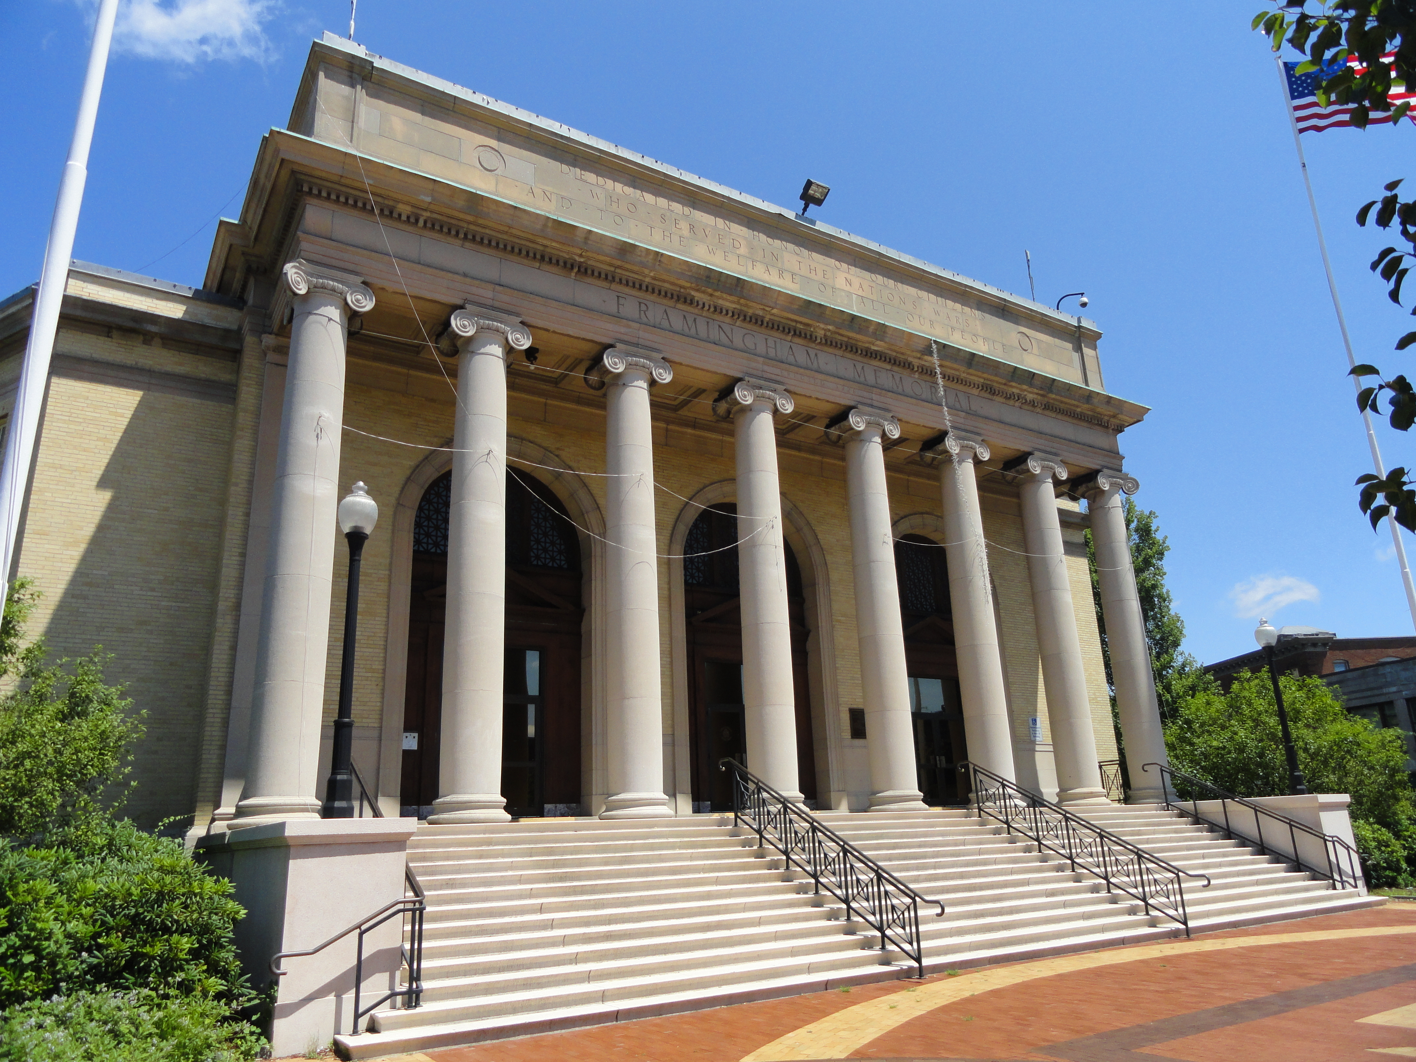
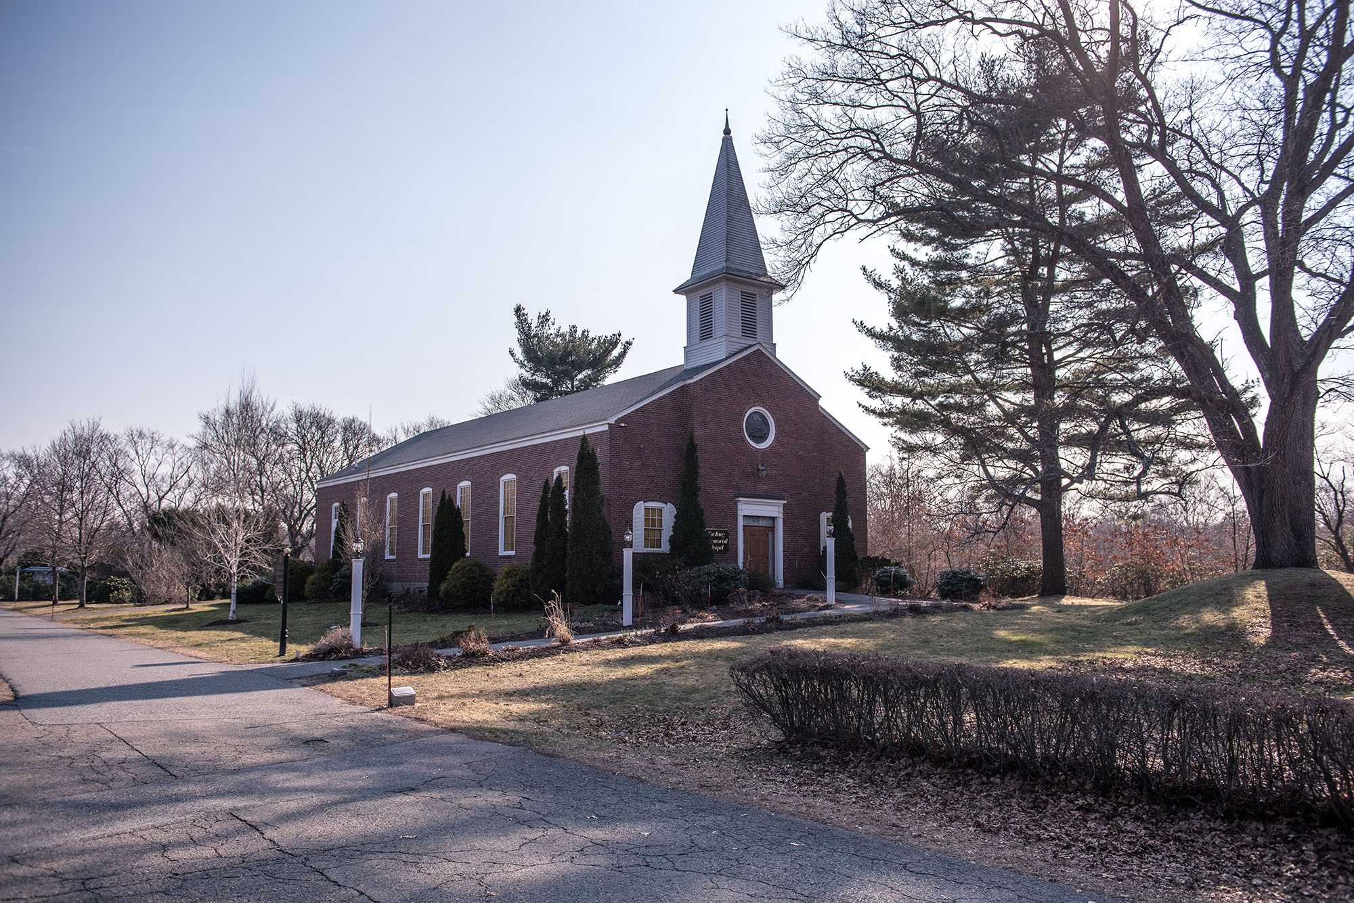
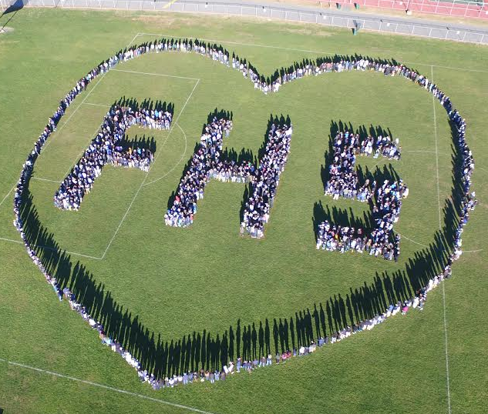
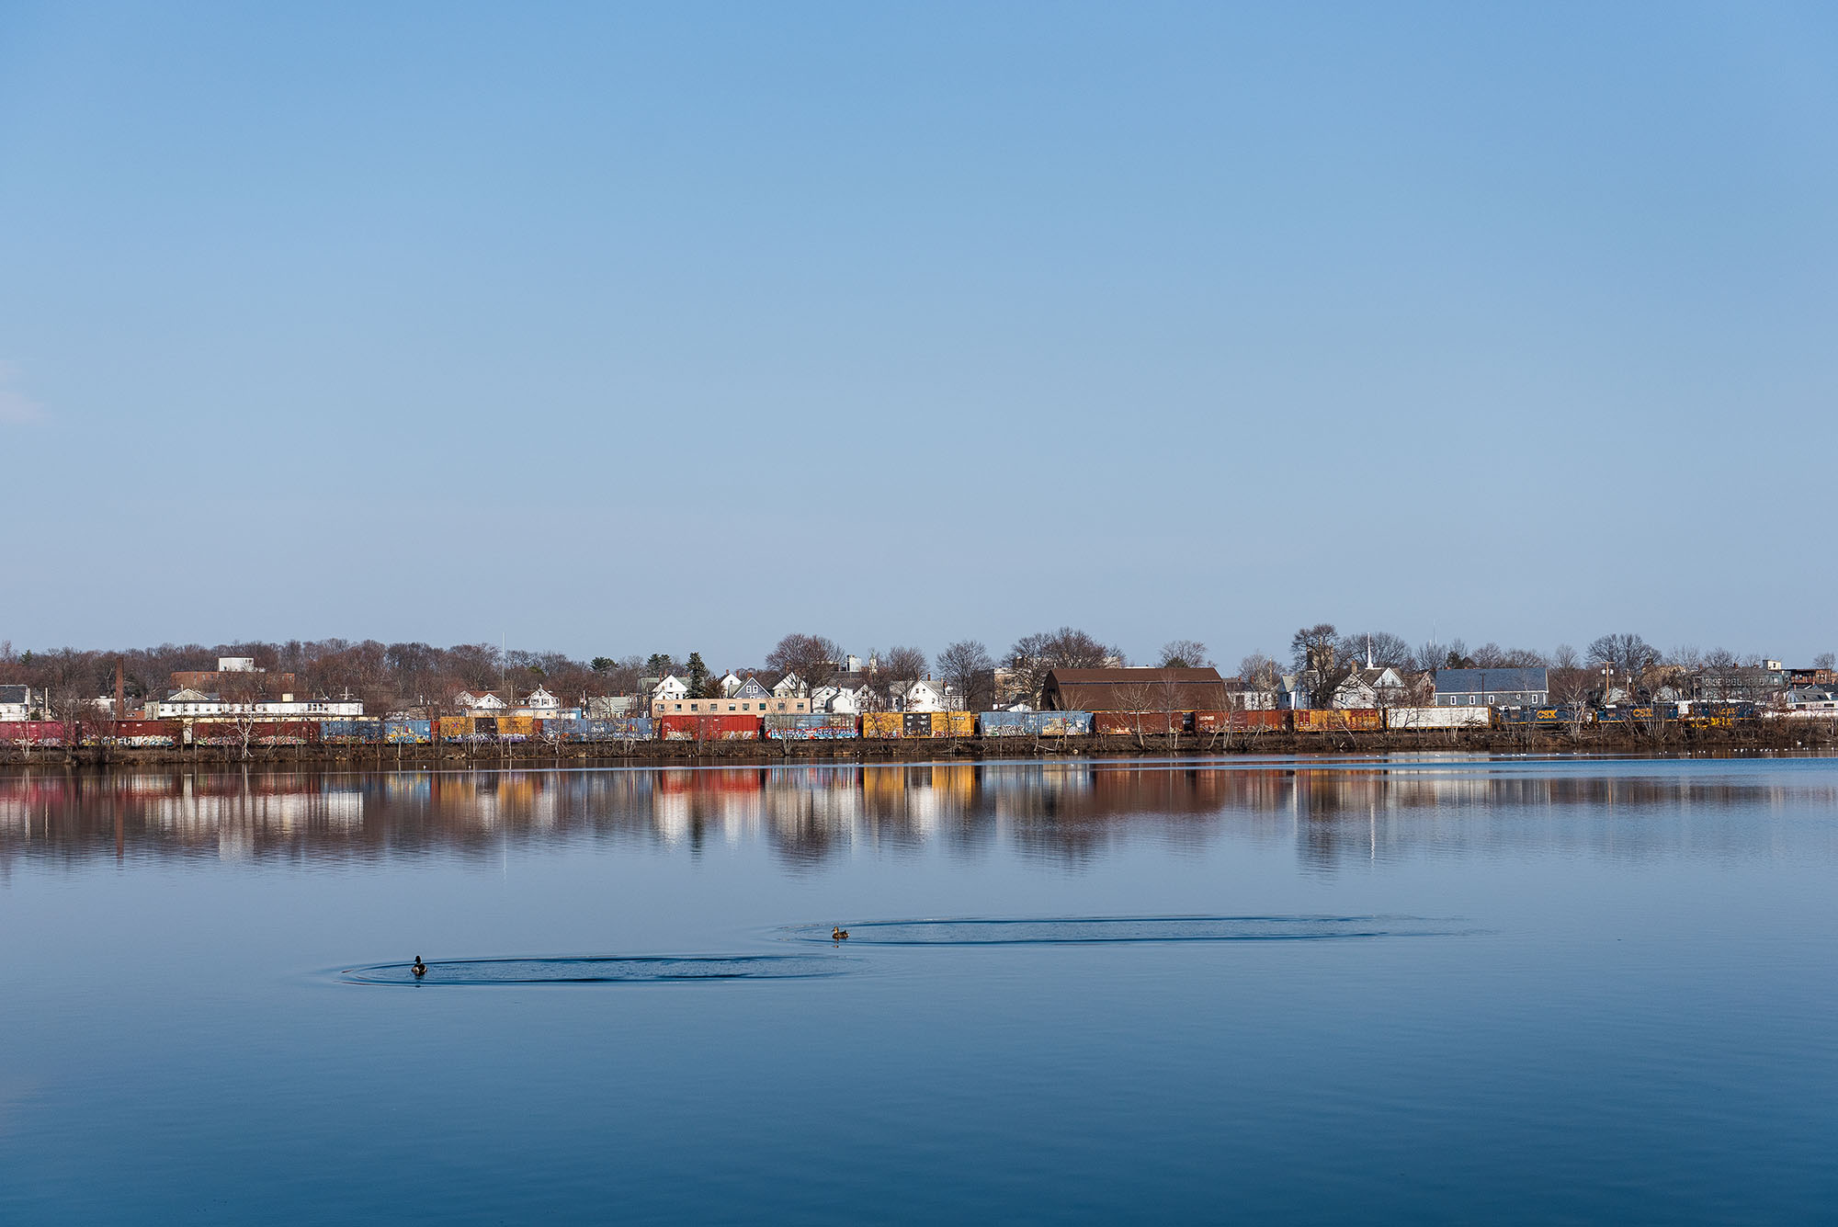
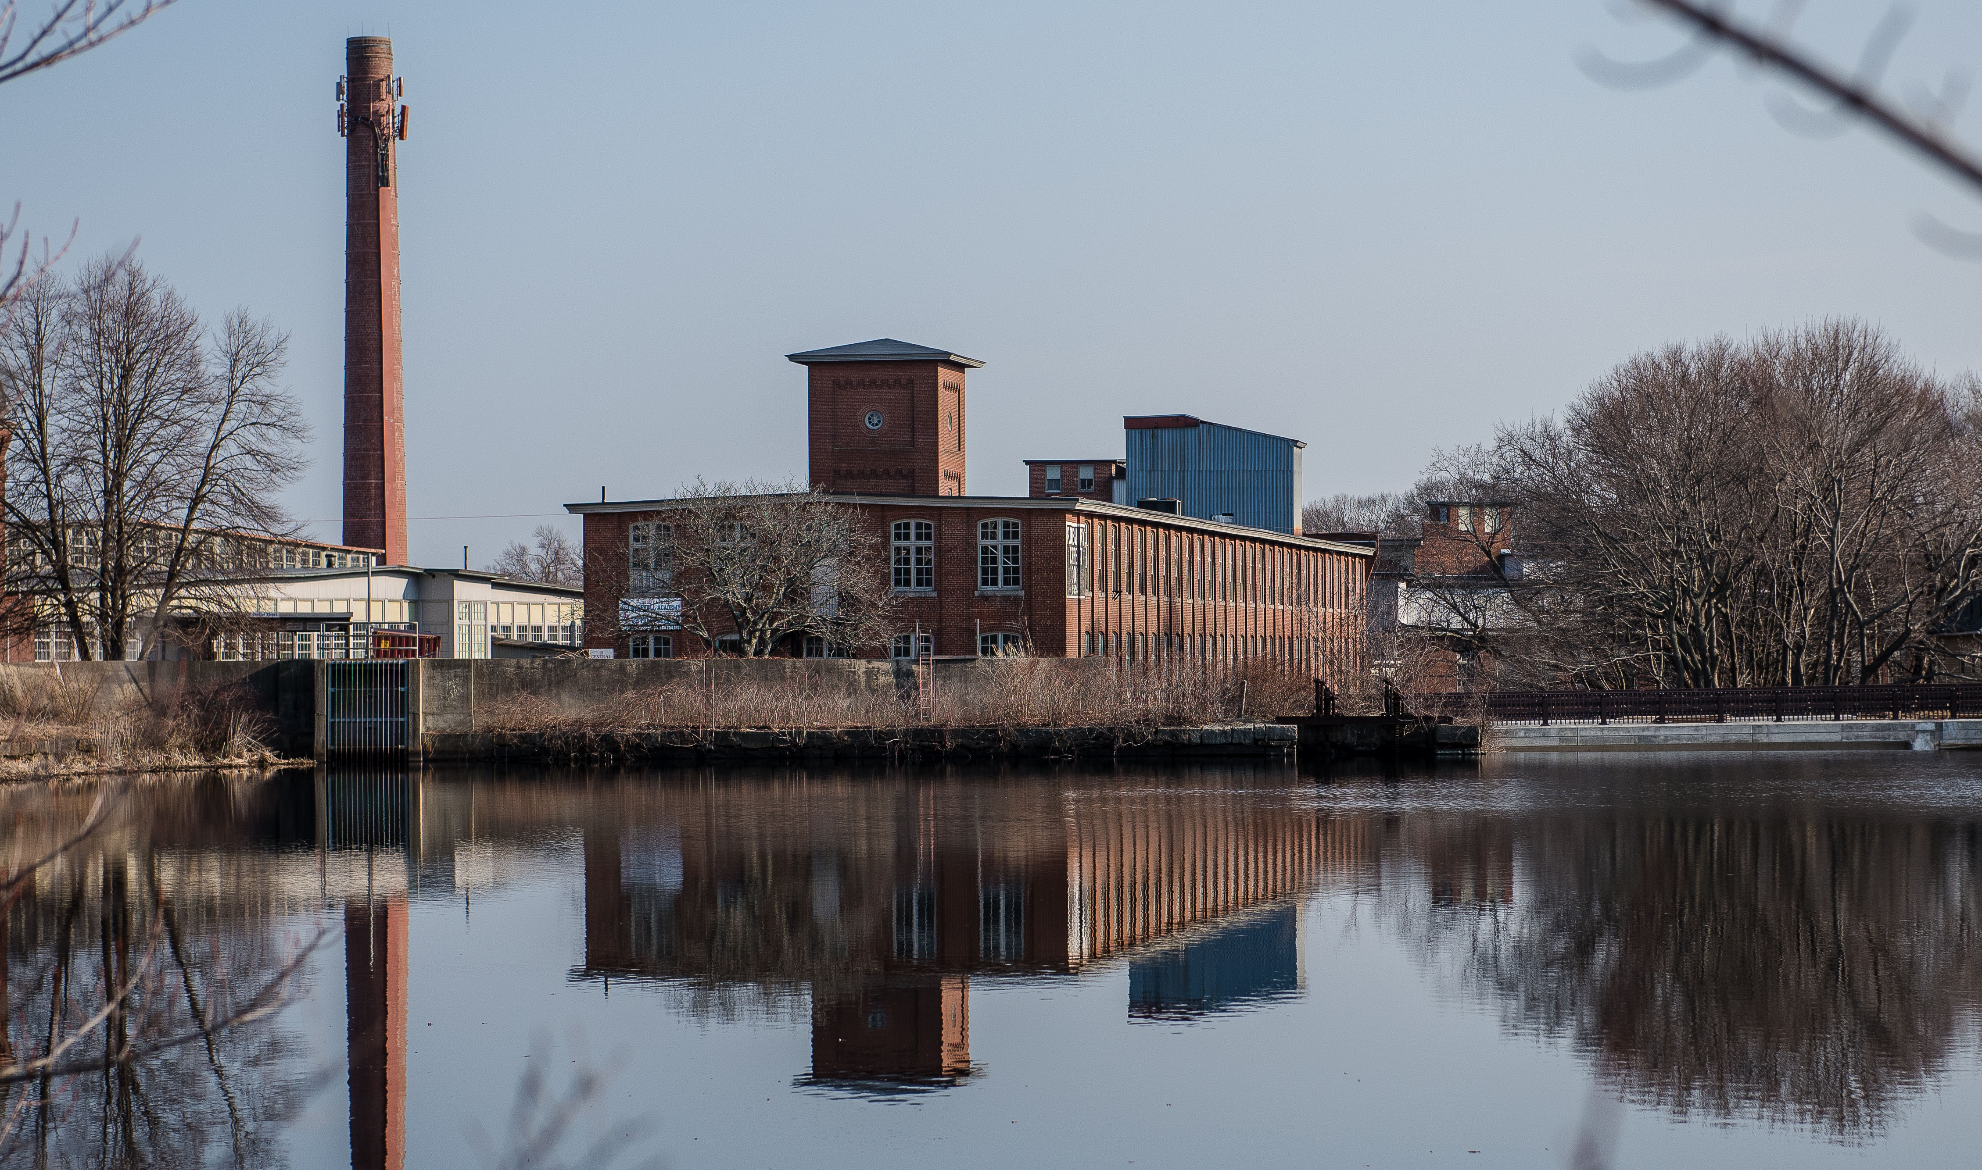
Framingham: a great place to live, learn, work and play

Slide 44

Pride in our Town
All of us are rightfully proud of Framingham. The pride that each of us feels for Framingham needs to be better reflected in Framingham’s government.
Our local government needs to represent all of us and support vibrant neighborhoods, quality schools, safe and secure homes, value elders, celebrate diversity, support local businesses, promote community participation, care for those in need.

Slide 45
On Tuesday, April 4, 2017, the voters will decide …
Shall Framingham approve the new home rule charter recommended by the charter commission as summarized below?
        YES ☑
        NO ◻
Summary of Home Rule Charter
The home rule charter provides for a full-time elected Mayor serving a 4-year term, and an elected 11-member Town Council composed of nine district members serving 2-year terms and two at-large members serving 4-year terms. The Mayor replaces the Board of Selectmen as the Town’s chief executive, and the Town Council, meeting at least monthly, replaces the Representative Town Meeting.
The School Committee will have 9 district members serving 2-year terms; the Mayor shall serve as the 10th member voting only to break a tie. The terms of the Board of Library Trustees and the Board of Cemetery Trustees will be extended to 4 years, with half the membership elected at alternating municipal elections.
Elections will be held in November of odd-numbered years. The charter establishes a Licensing Commission and a Traffic Commission. Financial management provisions include creation of a Strategic Initiatives and Financial Oversight Committee to consider the town’s financial condition and make recommendations on the Town’s future needs.
Several citizen “safeguard” provisions allow citizens to petition for measures through an initiative process, repeal a measure approved by the Town Council through a referendum process, and remove from office the Mayor, Town Council members, or School Committee members under certain circumstances by petitioning for a recall election. The proposed charter also establishes procedures for voters to bring matters before the Town Council and School Committee for a hearing, and creates the position of citizen participation officer to improve communication and outreach between the voters and the municipal leadership.
Finally, the Charter provides for the automatic and periodic review of the Charter to ensure that it continues to evolve to meet the needs of Framingham. The first such review will be five years following adoption of this charter.

